Slide 1
Free Financial Education Resources for Educators & the Use of Technology
Brittany Burroughs
Notes:
Good morning my name is Brittany Burroughs and I am a community affairs specialist in the outreach and program development section at FDIC.

Slide 2
Agenda
Money Smart for Young People Overview
MSYP Web Based Tools
Other Web Based Tools:
Podcast
CBI
Coming soon in 2020
Other Resources
Notes:
Before we begin, let’s go over our agenda for today.

Slide 3
The FDIC
An independent federal agency
Major responsibilities:
Insuring deposits
Bank supervision
Failed bank resolution
Economic Inclusion
Notes:
An independent agency of the federal government, the FDIC was created in 1933 in response to the thousands of bank failures that occurred in the 1920s and early 1930s.
The Federal Deposit Insurance Corporation (FDIC) preserves and promotes public confidence in the U.S. financial system by insuring deposits in banks and thrift institutions for at least $250,000.
In addition, the FDIC provides financial education resources, such as Money Smart, to financial institutions as one way it meets its mandate under the Community Reinvestment Act (CRA) to encourage financial institutions to meet community credit needs.

Slide 4
FDIC’s Money Smart Initiative
Money Smart for Adults
More than 3 million people
Longitudinal data showing effectiveness
Youth version
Older Adults version (w/ CFPB)
Small Business version (w/ SBA)
Money Smart for Young People
Notes:
Money Smart is available free of charge in several formats: to teach to consumers or for consumers to learn online, for different age groups, and in various languages. More than 3 million consumers have been reached with Money Smart since its creation in 2001.
The FDIC focuses its financial education outreach to organizations and entities that can use the FDIC’s resources to train and otherwise reach consumers, particularly low- and moderate-income consumers and unbanked and under-banked consumers. Money Smart is delivered by countless organizations. About 1,300 financial institutions, non-profit organizations, and government agencies have joined the FDIC’s Money Smart Alliance.
Research confirms that our Money Smart curriculum can be an effective tool to help unbanked adults develop banking relationships. A majority of those surveyed reported an increase in personal savings, a decrease in debt, a better understanding of financial principles, and an increased willingness to comparison shop for financial services.

Slide 5
Youth Financial Education
More than 1 in 6 students struggle with basics such as recognizing the difference between needs and wants
Research shows financially capable young people are more likely to become financially secure adults
Notes:
Why are we here today?
I think we can all agree that there is a need for effective financial education of young people in the US.
The FDIC knows that financial education has the potential to help improve how people manage their finances and these changes are observable long after the training.
Other studies, including those published by the US Treasury Department, point to the promise of youth financial education tied to access to a savings account.

Slide 6
Goals
Give K-12 educators resources they can use to feel prepared and confident
Encourage parents and caregivers to have conversations and do activities with their kids
Promote hands-on learning, with a particular focus on financial education tied to savings accounts
Notes:
In April of 2014, the FDIC and CFPB signed an agreement to leverage our strengths by working together to improve financial education and the decision-making skills among American youth. The goal of the CFPB-FDIC partnership is to empower youth to make better financial decisions to achieve their own goals, throughout the stages of their lives. We are working towards the goal by providing effective, tailored financial education materials and resources to youth, parents/caregivers, and teachers.

Slide 7
Money Smart for Young People Series
Money Smart for Young People series:
Grades Pre-K-2
Grades 3-5
Grades 6-8
Grades 9-12
Notes:
The Money Smart for Young People series features four free curriculums that are designed to promote financial understanding in young people. Money Smart curriculums are available for:
Grades Pre-K-2,
Grades 3-5,
Grades 6-8, and
Grades 9-12.

Slide 8
Series Highlights
Every curriculum includes:
Multiple lessons that can be taught alone or in combination
Standards alignment charts
Ideas for grade-level modification
Real-life exercises and examples
Suggestions for optional books or online games/tools that can reinforce student understanding
Ideas to integrate into existing academic subjects such as English, Mathematics, and Social Studies
Notes:
The Money Smart curriculum takes into consideration feedback received from the diverse focus groups of teachers and parents/caregivers who reviewed all materials to determine: ease in use; integration into existing curriculum; and tools to assist in teaching financial literacy.

Slide 9
Involves Educators, Students, and Parents/Caregivers
Resources for:
Teachers
Educator Guide
Overheads
Students
Parents/Caregivers
Resources to support learning
Conversation-starters
Activities
Notes:
Money Smart for Young People involves the teacher, student, and parents.
The Educators Guide offers lesson plans that include hands-on activities to promote student participation in the learning process. Grade level modifications are identified throughout the activities. We also offer Teacher Presentation Slides – these provide helpful visuals, as well as challenge exercises and reflective prompts to support the activities in each lesson. Both the slides and Educators Guide are provided in PDF and Word formats.
For students, each curriculum includes worksheets and other resources that let students explore the topics covered in each lesson and apply their new knowledge. These worksheets can be found in the Educator Guides and, for Grades 3-12, in a standalone Student Guide. The Student Guides also provide resources the participants can use after the class. For instance, the guide includes resources such as sample budgets, tips how to save money, and a loan comparison worksheet.
A Guide for Parents/Caregivers: Information about topics and terms being covered in class, conversation starters, online and literary sources, along with activities to try at home and around town. These guides can be used on a stand-alone basis by parents whose kids are not necessarily going through Money Smart classes.

Slide 10
Grades Pre-K-2
Educator Guide Lessons:
Counting Coins - Understanding Currency
Learn to Earn - Earning Money
Weighing Wants and Needs - Wants versus Needs
Ready. Set. Goal. - Setting Goals
Super Savers - Saving and Spending
Borrowing Bills - Borrowing and Lending
Notes:
This Educator Guide has six lessons with hands-on activities that engage preschool through second-grade students (roughly ages 4 through 8) in discussing and exploring introductory financial concepts.
For example, in Lesson 1: Focuses on counting coins and understanding currency.

Slide 11
Grades 3-5
Educator Guide Lessons:
Money Matters - Buying Decisions
Get Set for Goals - Setting Goals
Make a Plan - Budgeting
Save Your Money – Saving
Which Way to Pay? - Payment Options
Get Invested - Introduction to Investing
It’s Great to Donate! - Charitable Giving
Career Choices - Exploring Careers & Income
Notes:
The Educator Guide has eight lessons for third-through fifth-grade students (often ages 8 through 11). Example: in Lesson 2: Get Set for Goals, you’ll focus on short- and long-term goals, as they relate to saving, with real-world examples. Students then set their own savings goals and they’ll also explore factors - such as advertising and peer pressure - that might influence their decisions to spend or save money.

Slide 12
Grades 6-8
Educator Guide Lessons:
The Path to Success - Career and Job Opportunities
Bread and Butter - Introduction to Taxes
Designing Dreams - Financial Goals
Being a Savvy Shopper - Smart Shopping
Go with the Flow - Cash Flow and Budgeting
Super Savers - The Importance of Saving
How to Stash Your Cash - Savings Options
Money Doesn’t Grow on Trees - Investing Options
Give Credit Where Credit Is Due - Credit and Debt
Protecting Yourself - Protecting Your Identity
Risky Business - Financial Risk
Spend, Save, or Give? - Personal Financial Choices
Notes:
The Educator Guide has twelve lessons with hands-on, cross-curricular activities that engage sixth-through eighth-grade students (middle school) in discussing and exploring key financial concepts. For example, students begin to explore career fields and what thy want to do when they grow up.

Slide 13
Grades 9-12
Educator Guide Lessons:
Working Hard for the Money - Career Options
Designing Dreams - Financial Planning
Can You Pay Your Bills? - Spending and Budgeting
Boost Your Savings - Importance of Saving
Bank Your Bucks - Choosing a Banking Partner
Bread-and-Butter - Managing Your Paycheck
Capacity, Character, Collateral, Capital - Credit
The Almighty Dollar? - Credit Cards
As Easy as Pi - Financial Ratios
Convertible or Clunker? - Automobile Purchase
Risky Business - Risk Management and Insurance
Halls of Knowledge - Financing College continued….
Notes:
The Educator Guide has twenty-two lessons for ninth-through twelfth-grade students. And the lessons and topics are much more advanced.
For example, student loans and purchasing an automobile are covered. As well as many other activities.

Slide 14
Grades 9-12 (continued)
Educator Guide Lessons:
The Policy of Personal Choice - Understanding the Economy
Increasing the Value of Your Money - Financial Markets and Investing
Road to Retirement - Retirement Planning
Crash Pad - Homeownership and Renting
Pocket Giving - Charitable Giving
Paving the Future - Estate Planning
Financial Sleuth - Financial Resources
Protect Yourself - Consumer Protection
Launching Your Dream - Entrepreneurship 1: Starting a Business
Maintenance Mode - Entrepreneurship 2: Maintaining a Business

Slide 15
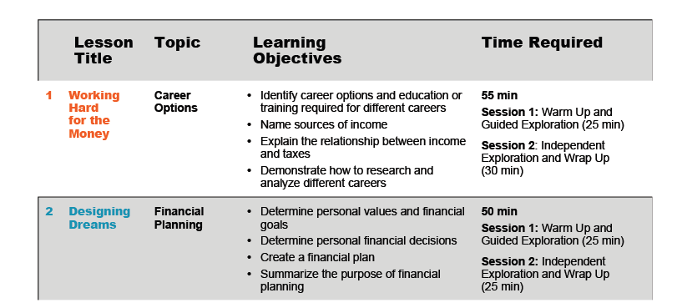
Sample Educator Guide: Lessons at a Glance Section
This section provides the teacher with a summary of lessons, objectives and suggested time required for each lesson.
Notes:
The Lessons at a Glance section provides the teacher with a summary of lessons, objectives and suggested time required for each lesson. It’s a great snapshot of what is in the curriculum and allows educators the information needed to design lessons or embed financial literacy topics into existing curriculum.

Slide 16
Sample Educator Guide: Extended Exploration Section
Notes:
Extended Exploration
On page 117-118 of the educator’s guide there are additional examples of activity ideas across subjects.

Slide 17
Connection to Standards
Aligned with:
Common Core English Language Arts
Common Core Mathematics
Partnership for 21st-Century Skills
Jump$tart National Standards in K–12 Personal Finance
Council for Economic Education National Content Standards in Economics
Sample Alignment Chart
Notes:
Each level of the curriculum is linked to several key educational standards. The National Jump$tart Coalition Financial Literacy Standards, Common Core standards for English Language Arts and Mathematics, National Standards in Economics by CEE and Partnership for 21st Century Skills. There is a table in the back of each level that shows direct connections to specific standards.

Slide 18
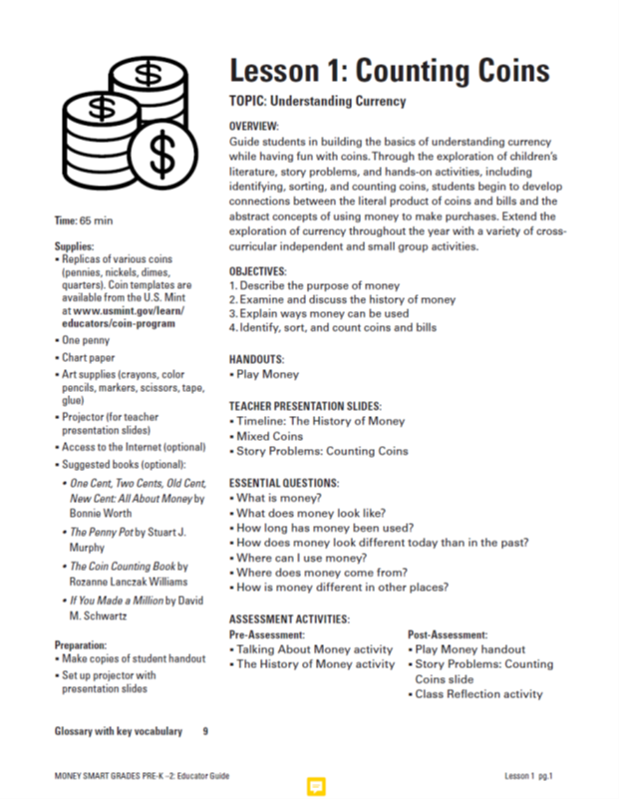
Money Smart for Young People Changes
Content will remain the same.
New and improved look and format that is cleaner, more modern, better organized, and easier to read.
Updated links to suggested sites to reinforce learning.
Student handouts have been updated to look more current and less dated.
The new format uses slightly different icons to identify each lesson.
Black text on a white background makes it easier to read if printed in black and white.
The Extended Exploration section has been expanded to include CFPB’s financial literacy Building Blocks activities.
Notes:
Earlier this year, the FDIC asked ICF to provide feedback on a new proposed format for Money Smart for Young People (MSYP) lesson plans. In addition, ICF solicited feedback from educators, who provided detailed comments on the clarity and usability of the new proposed format from the perspective of end users.

Slide 19
Money Smart for Young People Changes
Notes:
Questions on New Curriculum?

Slide 20
MSYP Web-Based Tools
Teacher Online Resource Center
fdic.gov/teachers
CFPB & FDIC resources
Videos
Shopping Wisely
Setting Savings Goals
A Field Trip to the Bank
Parent and Caregiver Resources
consumerfinance.gov/moneyasyougrow
Notes:
The curriculum is available through the Teacher Online Resource Center. The FDIC and CFPB collaborated to create the Teacher Online Resource Center so teachers can access resources from across FDIC and CFPB that can support financial literacy instruction. For example, in addition to MS for Young People, we link to Ask CFPB an interactive online tool. It gives clear, unbiased answers to common financial questions. It offers general information and explanations for financial terms. It is available in English and Spanish.
Most noteworthy, I wanted to let you know the site features three videos that offer ideas on how to teach about money in the classroom. Pointers are provided in the videos on how to adapt them to different grade levels (they are filmed in a middle school setting). The three videos are:
“Shopping Wisely” -This video uses a simulated shopping trip to help students make better informed decisions about how to spend their money.
“Setting Savings Goals”- A teacher presents approaches to help students understand the basics of saving money.
“A Field Trip to the Bank”- A middle school class takes a field trip to the bank to learn about its operations.

Slide 21
Parent/Caregiver Guide
Organized around themes.
Each theme corresponds to classroom lessons.
Notes:
The parent guide is meant to serve as a connection between the classroom and the home. The topics covered in the classroom are identified by the lesson and an overview is given for each topic. The information that the students have been given in the classroom is provided for the parents along with key terms and definitions. The conversation starters are great tools to bring financial topics to the table and activate money talk at home.
Our studies have found that there are parents who do not know a great deal about basic finances and the parent guide can be a very useful tool for them, not only to assist their child, but to help their own financial lives. This can also be a great resource to use for PTA meetings, parent education nights and other community activities.

Slide 22
Sample Parent/Caregiver Guide: Grades 9-12
Notes:
The parent guide is currently being transitioned to our money smart for young people home page. The goal is to make it more accessible for parents. We want parent’s to be able to easily access it via their phone.

Slide 23
Money Smart - A Financial Education Program
Notes:
Now to transition to our other web based tools and resources.
Our website was recently redesigned and is set up under three categories Teach, Learn and Implement.
Teach: with Money Smart for Young People, Money Smart for Adults, Money Smart for Older Adults and Money Smart for Small Business
Learn: Computer-Based Instruction and Podcast
Implement: Money Smart News, Train-the-Trainer, Delivery Strategies

Slide 24
Money Smart for Adults
Notes:
The newly updated Money Smart for Adults instructor-led curriculum provides participants with practical knowledge, skills-building opportunities, and resources they can use to manage their finances with confidence. Instructors can use it to deliver unbiased, relevant, and accurate financial education whether they are new to training or experienced trainers.
All of the modules are now ready to be downloaded on our teach/MSA page
Updated in 2018 to include Mobile Banking apps and other technology based tools.

Slide 25
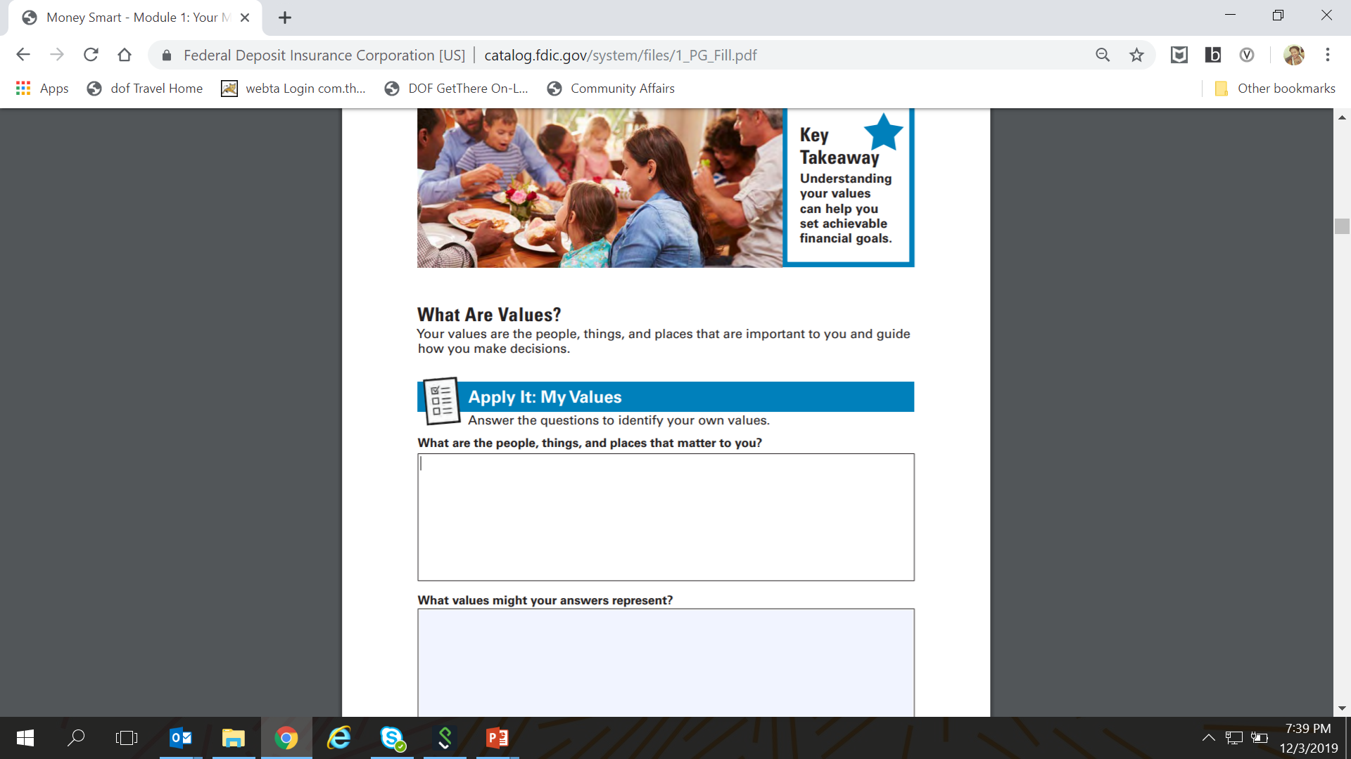
Fillable PDF Files
Participant Guides
Notes:
We are currently working on making our Participant Guides into fillable PDF’s so they can be used via computer or phone. There are currently two available and we are working on making them all fillable.

Slide 26
Train the Trainers
Videos
MSA Introduction
MSA Instructor Guide
MSA Participant Guide
MSA Guide to Presenting
MSA on Module 6: Credit Reports and Scores
Quarterly Webinars
Notes:
These videos quickly orient trainers to the Money Smart materials. Train-the-Trainer videos are available for Money Smart for Adults and Money Smart for Young Adults. They are about 5 -10 minutes each, with the exception of a TTT on module 6: Credit Reports and Scores which is 55 minutes. Although a shorter TTT is available also. We will be doing similar videos on each module in the future.
In addition to the online videos, we also host quarterly TTT via webinar. You must register in advance to participate. These are more interactive as participants are available to ask questions and receive immediate answers.
Both the videos and information about upcoming TTT can be found on our website.

Slide 27
Money Smart Podcast Network
Notes:
15 minutes per lesson.

Slide 28
CBI
http://moneysmartcbi.fdic.gov/
Notes:
Computer-Based Instruction
Can be either a:
Supplement to instructor-led training
Stand-alone training/self-paced
Adult and Young Adult Tracks
Certificates of Completion
Available in English and Spanish

Slide 29
Benefits of the CBI
Compatible with desktops and mobile devices
Flexible
Can be completed in one session or pick up where the user left off
Interactive
Free
Notes:
Can be completed on desktops or mobile devices (phones, tablets, and laptops)
Select only the modules that are of interest to you or modules that you need.
Provides flexibility so you can learn at times that are most convenient.
Complete at own pace
Module(s) can be completed in any order
Complete one or multiple modules
Participants are actively engaged throughout each module
Free!

Slide 30
Access
URL: https://moneysmartcbi.fdic.gov/
Notes:
CBI URL is preferable because it’s the most up-to-date version.
Order the CD from our Online Ordering System only if you do not have internet access. Otherwise, please use the URL.

Slide 31
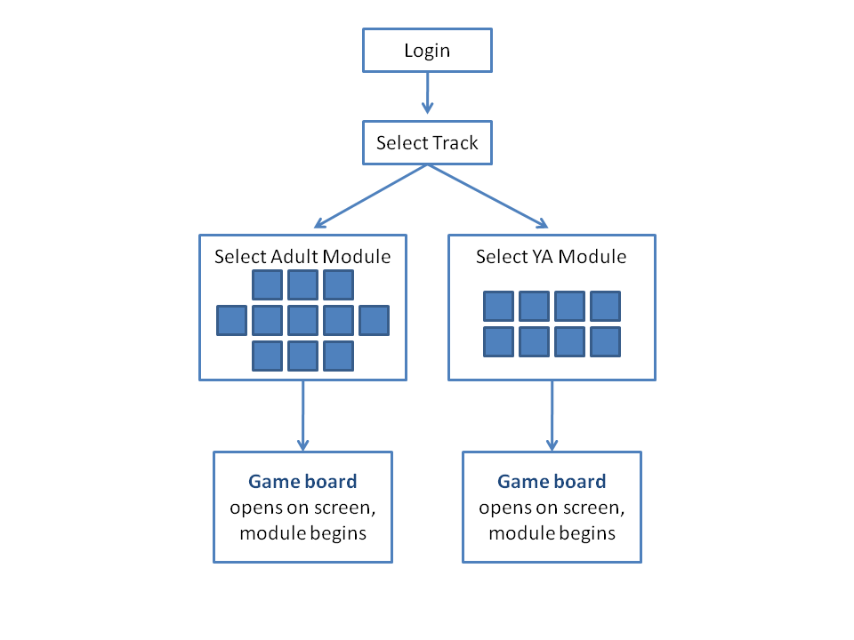
CBI Structure
Notes:
As with the MS – Teach products, we continue to keep the CBIs up to date with new laws and regulations, and periodically we do an complete revamp.
Once a user has logged into the CBI, he/she is provided the option of taking the adults or young adults modules.

Slide 32
Certificate of Completion
Notes:
Certificate of Completion for the “Pay Yourself First” module. Participants can list the successful completion of modules on resumes and on loan applications if applicable.

Slide 33
Coming Soon in 2020
Notes:
By the fall of 2020, the FDIC will be launching our suite of new online financial education games – called How Money Smart Are You?
There will be one track for everyone (current CBI has a track for adults and a separate track for young adults)
People can log in if they want to earn a certificate, or play without logging in (current CBI requires everyone to log in, even if they don’t want/need a certificate)

Slide 34
Coming Soon in 2020
Why New Online Games?
We launched the new Money Smart for Adults (MSA) instructor-led version in November 2018
Our current CBI game is based on the 2010 version of MSA
We needed a fun, engaging game based on the new content

Slide 35
Coming Soon in 2020
Notes:
There will be 14 separate games – with the same titles as in Money Smart for Adults, covering the same topics. (read a few names if you want to)
They are listed in alphabetical order here.
Games can be played on a computer or on a smartphone

Slide 36
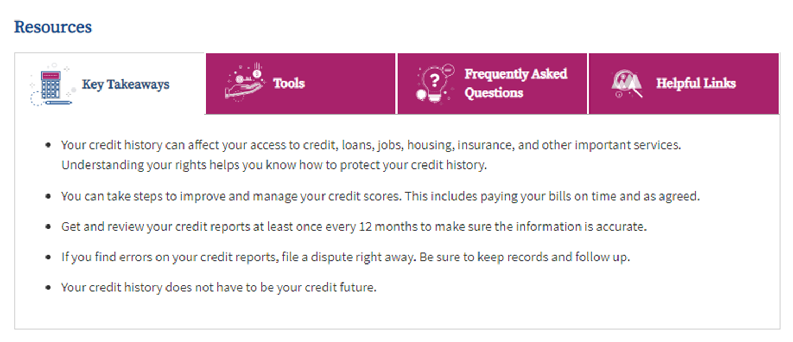
Coming Soon in 2020
Each Game has Resources
Notes:
Each game has its own set of resources – Key Takeaways, Tools, Frequently Asked Questions, and Helpful Links for more information.
Tools are based on the activities in the instructor-led version.

Slide 37
Money Smart News
View online or subscribe
Provides:
Updates on the Money Smart program
Success stories. Samples:
Money Smart for Young Adults: Success Stories and Strategies for the School Year
Personal Statements & Essay Contests: Sharing Money Smart and Success Stories
Passing the Test: Success Stories and Tips for Teaching Kids About Money
Notes:
Let’s discuss a few other helpful resources.
One of the items you will find on this website is Money Smart News. You can subscribe online and receive it via email, or you can read it online. You can view back issues on the FDIC website. It is a quarterly publication.
It provides you with updates on the Money Smart program and other updates we think would be of interest to financial educators. It also includes success stories. We highlight on the Teacher Online Resource website some sample success stories that we hope can provide inspiration as to how you use the curriculum. I list three of these here.
Please consider sharing your success stories with us for publication in Money Smart News. Information on how to make a submission is on the website.

Slide 38
FDIC Consumer News
www.fdic.gov/consumernews
Quick Links to Articles (right-hand side)
Notes:
FDIC Consumer News is also helpful for young people, parents and caregivers.
It provides practical guidance on how to become a smarter, safer user of financial services. Issues and selected articles offer helpful hints, quick tips and common-sense strategies to protect and stretch your hard-earned dollars.
You can find a link to it from the Teacher Online Resource Center website.

Slide 39
Money Smart Alliance
Money Smart Alliance Program
Eligible organizations
Easy to join the Alliance online
Notes:
The FDIC recognizes organizations that significantly contribute to the delivery of Money Smart to consumers and small businesses through the Money Smart Alliance Program.
Alliance members agree to use or promote the Money Smart curriculum. This is done by teaching Money Smart . Alliance members also provide feedback to the FDIC that can help improve the Money Smart program.
To support the Alliance, the FDIC shares updates and other information with Alliance members that can strengthen their efforts, including the quarterly Money Smart News publication.
The FDIC welcomes these types of organizations to join the Money Smart Alliance:
Federally insured financial institutions,
Non-profit organizations that have been recognized as tax-exempt by IRS,
Federal agencies,
K-12 schools or school districts,
Colleges or universities, and
Other state or local government agencies (including governmental entities)
Individuals and other types of organizations are not eligible to join the Money Smart Alliance at this time.
If you would like to join the Money Smart Alliance please complete this short form. There is no separate process to join the MSSB Alliance.
FDIC lists Money Smart Alliance members on the FDIC website if they wish to be accessible to consumers looking for training or organizations.

Slide 40
Questions?
Any Questions?
Notes:
What are some of the challenges that you all experience with teaching financial literacy in the classroom? How do you use technology?

Slide 41
Contact Information
Brittany Burroughs
bburroughs@fdic.gov
www.fdic.gov/moneysmart

